Slide 1
Palladio Workflow Engine
SDQ Lerngruppe 2010

Slide 2
Motivation
Structure and run activities consisting of a set of actions
Make actions reusable and configurable
Example: Run simulation
Read in Eclipse configuration
Load PCM models
Check PCM model validity
Generate code
Consists of sub-step
Run simulation
Clean up all side effects

Slide 3
Idea: Plug together configurable workflow jobs
Could be used for running multiple simulations without new code generation
Reusable for PCM Solver!
Load PCM models
Check model validity
TransformPCMTo CodeJob
Run simula-tion
Configuration
Configuration
Configuration
Configuration
Xpand Genera-torJob
Xpand Genera-torJob
Xpand Genera-torJob
…
File = repository
File = system
File = allocation
Clean up: Each Job provides a cleanup method and thus encapsulates the required clean up actions. Example: Delete generated code.

Slide 4
Concepts
Job
Configuration
ConfigurationBuilder
Blackboard

Slide 5
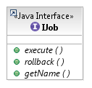
Job
Defines an activity
Can be composed
Three steps
Construct job
Execute job
Call rollback (optional)
Configuration is passed to the constructor
A prepared chain of jobs can be executed without knowledge what jobs they are.

Slide 6
Example Composed Job
Composite job: Calls all its children when executed in the order they were added
package de.uka.ipd.sdq.workflow.pcm.jobs;
public class LoadPCMModelsIntoBlackboardJob
extends OrderPreservingBlackboardCompositeJob<MDSDBlackboard>
implements IJob, IBlackboardInteractingJob<MDSDBlackboard> {
/**
* Constructor of the PCM loader job
* @param config A PCM workflow configuration containing the list of URIs
* where to find the PCM model files
*/
public LoadPCMModelsIntoBlackboardJob(
AbstractPCMWorkflowRunConfiguration config) {
super();
this.add(new PreparePCMBlackboardPartionJob());
this.add(new LoadPCMModelsJob(config));
}
}
Blackboard interacting: An MDSD blackboard is set and also set for all children
CompositeJob: Rollback is called for all children

Slide 7
Job Inheritance Tree
AbstractCompositeJob
Implements List<IJob>
Allows to add jobs to internal list
Calls each job‘s rollback for rollback
OrderPreservingCompositeJob
Execute: Executes contained jobs in the order they have been added
OrderPreservingBlackboardCompositeJob
Has setBlackboard method
Typed by a Blackboard type
Sets blackboard for contained blackboard interacting jobs before executing them

Slide 8
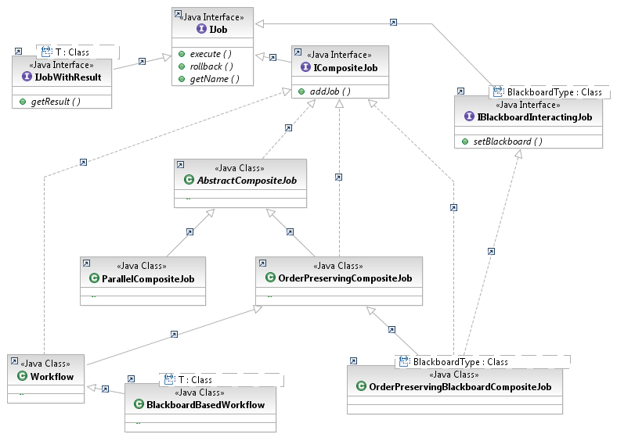
Available (Abstract) Jobs
Notes:
Workflow.java: * Implementation of a workflow. A workflow is a special composite job which
* executes all other jobs while displaying the progress in a progress
* bar to the user.
* Additionally, the Workflow has an internal WorkflowExceptionHandler
* that handles exception based on the environment (UI available or not).
* The given Progress Monitor will receive updates before and after a
* job is executed.

Slide 9
Configuration
Jobs are configured by passing configuration objects
Configuration contains info how to run the job
Examples
Which PCM files to load
How many measurements in SimuCom
Logging level
Which PCM solver to use (LQN, LQNSim, ...)
Which feature annotation to use
The built-in Eclipse ILaunchConfiguration is not used to make the workflows independent of being started from the run dialogue.
E.g. SimuCom is started as a web service in the SLA@SOI project

Slide 10
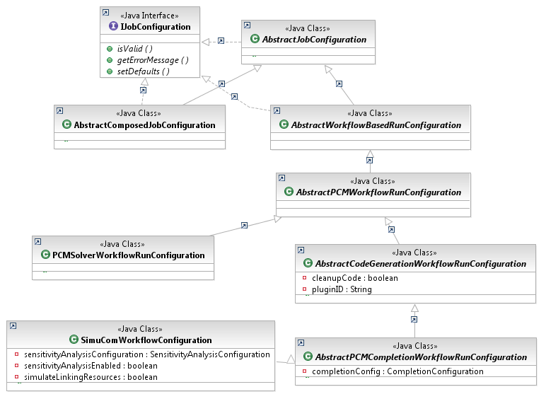
Configuration Hierachy
Only example attributes shown
Validation, requires error message template method
Allows to set interactive mode, user can act upon failures
Contains further PCM Solver configuration
Contains PCM model files URLs
Contains config for plugin generation and whether existing code can be deleted
Contains further SimuCom configuration
Contains feature model handling

Slide 11
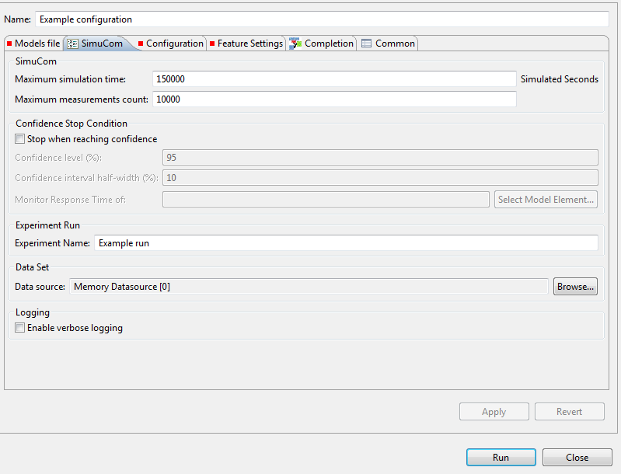
Example Eclipse Launch Dialogue
Saved as key-value-pairs in an Eclipse LaunchConfiguration
Calls your implementation of an Eclipse LaunchConfigurationDelegate

Slide 12
Launch Configuration Delegates
Create configuration from Eclipse run config
Called when you click run in Eclipse
Launch method called with Eclipse LaunchConfiguration
ILaunchConfiguration with Properties
You need to set monitoring, debug levels, loggers, …

Slide 13
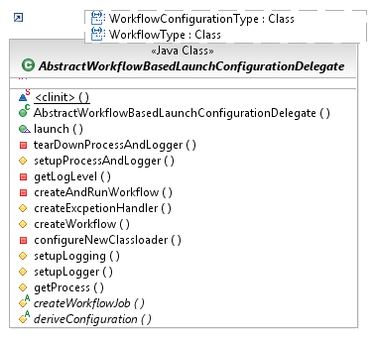
Workflow Launch Configuration Delegates
Abstract delegate handles Eclipse specifics
Remaining template methods
Create workflow jobs
Derive configuration
Just implement those!

Slide 14
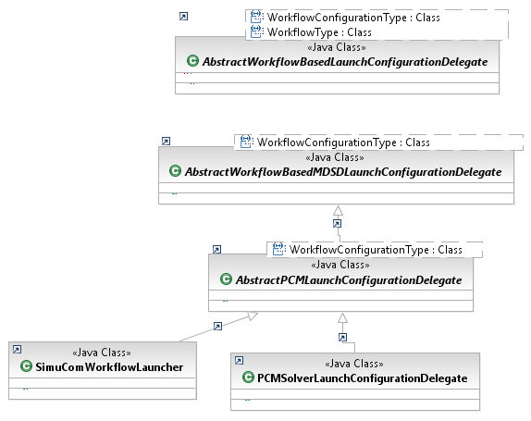
Delegate Hierachy
All Eclipse stuff, only createWorkflow and deriveConfig abstract
Addes abstract createBlackboard, fixes Blackboard type to MDSDBlackboard.
Implements createBlackboard and createWorkflow for PCM models
Derive SimuCom config
Derive PCM Solver config (fixes generic WorkflowConfigurationType)

Slide 15
Configuration Builder
Most Jobs require a certain type of configuration
Filling these based on the Eclipse input is encapsulated in Builders
Can be reused in multiple launch delegates

Slide 16
Configuration Builder Example
public class SimuComWorkflowLauncher extends
AbstractPCMLaunchConfigurationDelegate<SimuComWorkflowConfiguration> {
@Override
protected SimuComWorkflowConfiguration deriveConfiguration(
ILaunchConfiguration configuration, String mode)
throws CoreException {
SimuComWorkflowConfiguration config = new SimuComWorkflowConfiguration();
AbstractWorkflowConfigurationBuilder builder;
builder = new PCMWorkflowConfigurationBuilder(configuration, mode);
builder.fillConfiguration(config);
builder = new SimuComLaunchConfigurationBasedConfigBuilder(
configuration, mode);
builder.fillConfiguration(config);
return config;
}
}
Create the required config
Create a builder for the PCM config part
Let this builder fill in the PCM info (model file names, …)
Create a builder for the SimuCom config part
Let this builder fill in the SimuCom info (max measurements, where to store, …)
All info is contained here and can be read by a PCM model loader and by SimuCom

Slide 17
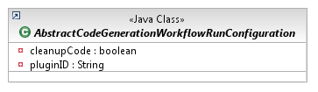
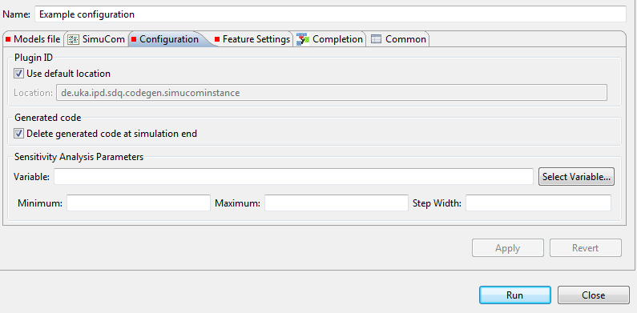
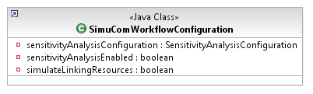
Mapping the Configuration
Clicking Run extracts configuration
Builder fills configuration
public void fillConfiguration(AbstractWorkflowBasedRunConfiguration configuration) throws CoreException {
SimuComWorkflowConfiguration config = (SimuComWorkflowConfiguration) configuration;
config.setSimulateLinkingResources(getBooleanAttribute(ConstantsContainer.SIMULATE_LINKING_RESOURCES));
config.setCleanupCode(getBooleanAttribute(ConstantsContainer.DELETE_PLUGIN));
config.setPluginID(getStringAttribute(ConstantsContainer.PLUGIN_ID));
…
Eclipse ILaunchConfiguration eConf:
("simulateLinkingResources" = false)
("clear", true)
("outpath", "...codegen.simucominstance")
("variable", "")
("minimum", "")
("maximum", "")
Builder is instantiated by delegate
new SimuComLaunchConfigurationBasedConfig Builder(eConf, mode);

Slide 18
Blackboard
Many Jobs require access to model files
Do not just store the URLs in the config
Load files just ones
→ Keep a blackboard with the model files
Jobs can access data from blackboard by an ID
Concepts
Blackboard interacting Jobs
MDSD Blackboard
EMF Resource Partitions

Slide 19
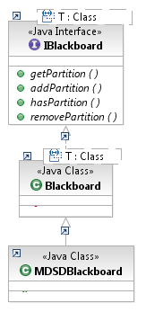
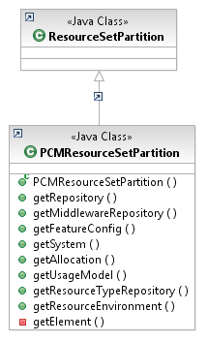
Blackboard Classes
Has several partitions with an ID and a type T to store information
Type T is fixed to a ResourceSetPartition to store EMF model instances
For PCM models, an MDSDBlackboard is filled with specialised PCMPartitions to conveniently access the model files

Slide 20
Workflow plugins
Workflow
Main concepts
Eclipse-dependent
Abstract classes with template methods
Launchconfig
Build configurations based on Eclipse launch configs
MDSD
Read in EMF models
OAW and MediniQVT support
PCM
Build PCM configuration
Useful PCM jobs
Tests

